Slide 1
Predicting Crime Severity:
A Machine Learning Approach
ALY-6140-Final
Presentation -
By Srishti

Slide 2
Table Of Contents
Introduction
Research Questions
EDA
Decision Tree Model Performance
Logistic Regression Performance
Conclusion
References

Slide 3
Introduction
Crime severity prediction is a crucial task for law enforcement agencies to allocate resources effectively and prioritize interventions. In this report, we explore the application of machine learning techniques to predict crime severity using a dataset containing information about various criminal incidents.
The dataset chosen is 'Crime_Data_from_2020_to_Present.csv,' comprising 836,941 records with 29 columns, including features like Date, Time, Area, Crime Code, and Location. The dataset meets the minimum requirement of 10,000 records and 12 usable features, providing a robust foundation for in-depth analysis. here are 12 usable features from the crime dataset:

Slide 4
DR_NO (Report Number): Unique identifier for each crime report.
Date Rptd (Date Reported): Date when the crime was reported.
DATE OCC (Date of Occurrence): Date when the crime occurred.
TIME OCC (Time of Occurrence): Time when the crime occurred.
AREA (Area Code): Numeric code representing the geographical area where the crime took place.
AREA NAME (Area Name): Name of the geographical area where the crime occurred.
Rpt Dist No (Report District Number): District number associated with the crime report.
Part 1-2 (Part 1 or Part 2 crime indicator): Indicator specifying whether the crime is categorized as Part 1 or Part 2 crime.
Crm Cd (Crime Code): Code representing the type of crime.
Crm Cd Desc (Crime Code Description): Description of the crime corresponding to the crime code.
Vict Age (Victim Age): Age of the victim involved in the crime.
LOCATION (Location of the crime): Description of the specific location where the crime occurred.

Slide 5
Business Question
Can machine learning models be used to predict the severity or type of crime based on various features such as location, time, demographics, or other contextual factors?
Which features are most predictive of crime severity or likelihood, and how accurate are the predictive models compared to each other?
How can the insights from predictive modeling be used to inform proactive measures for crime prevention or law enforcement strategies?

Slide 6
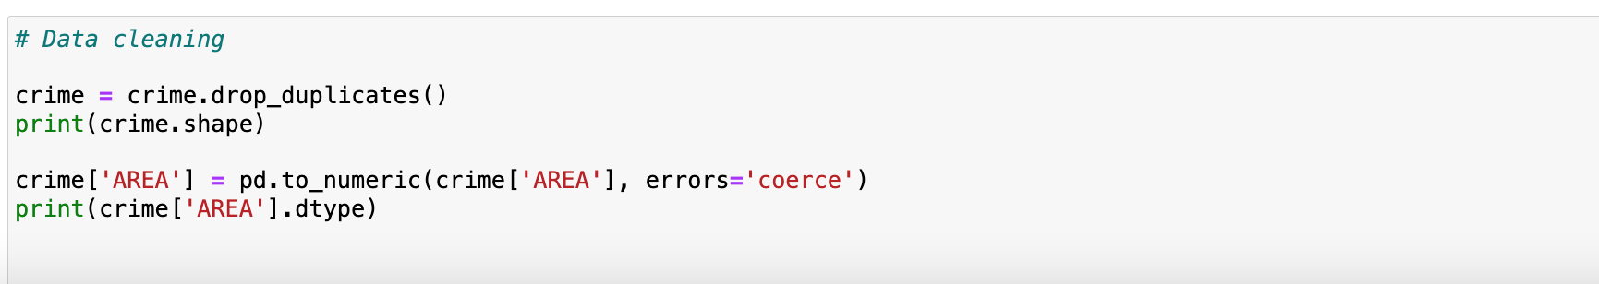
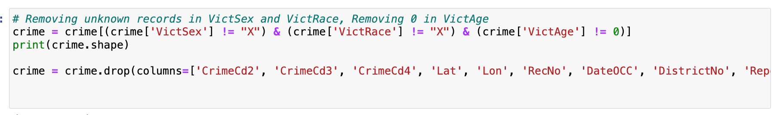
Data Processing
Conducted thorough data cleaning steps, including removing duplicates and handling missing values. Categorical features were transformed using one-hot encoding, and numerical features were scaled to ensure compatibility with machine learning algorithms. Additionally, engineered new features such as victim gender and weapon usage to enhance model performance.

Slide 7

Exploratory Data Analysis

Slide 8
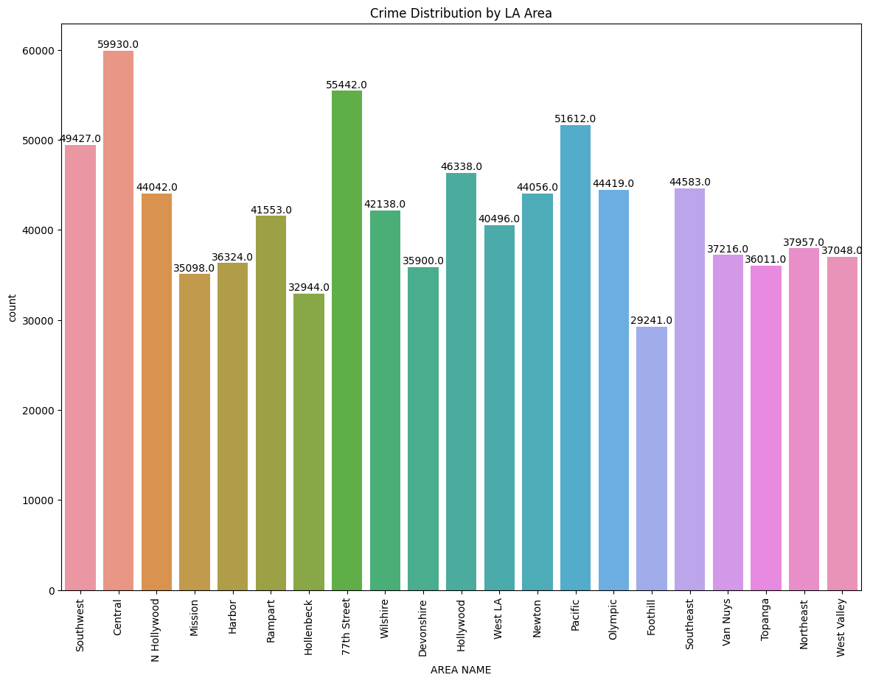
Crime Distribution

Slide 9
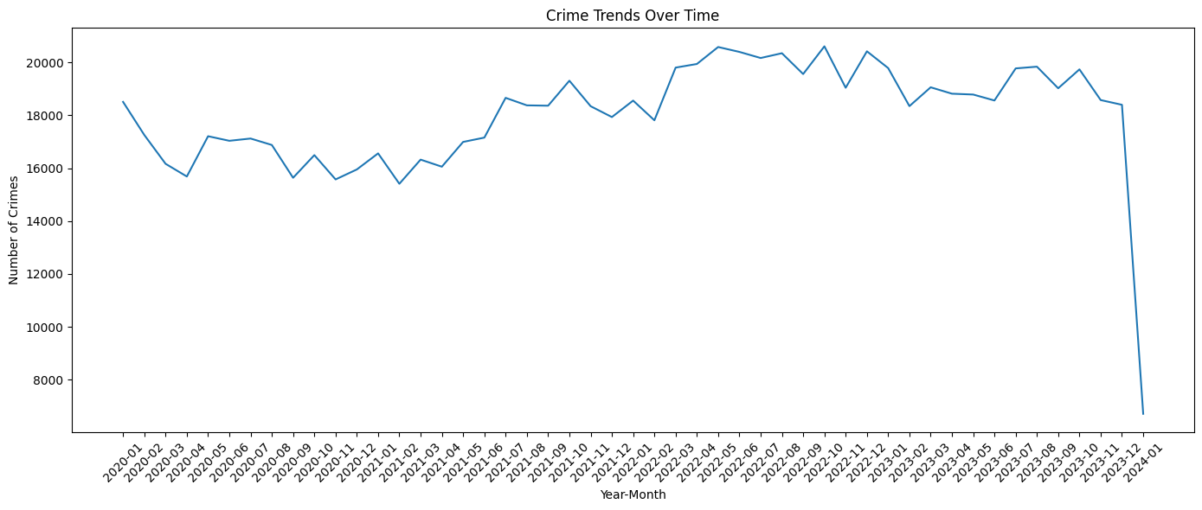

Slide 10
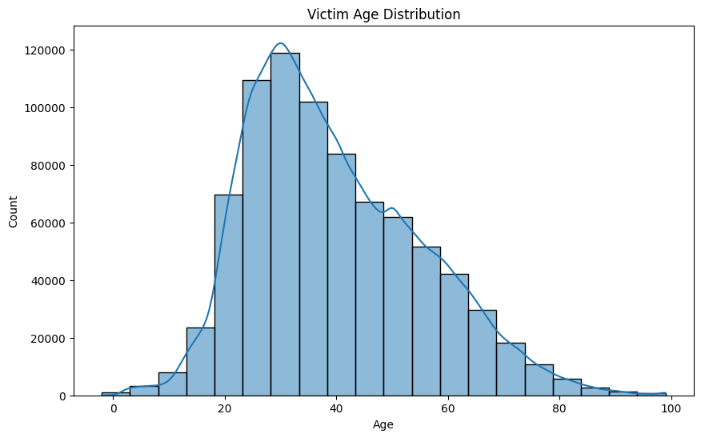
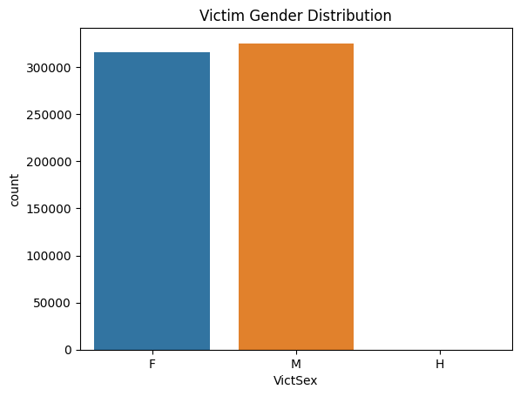

Slide 11
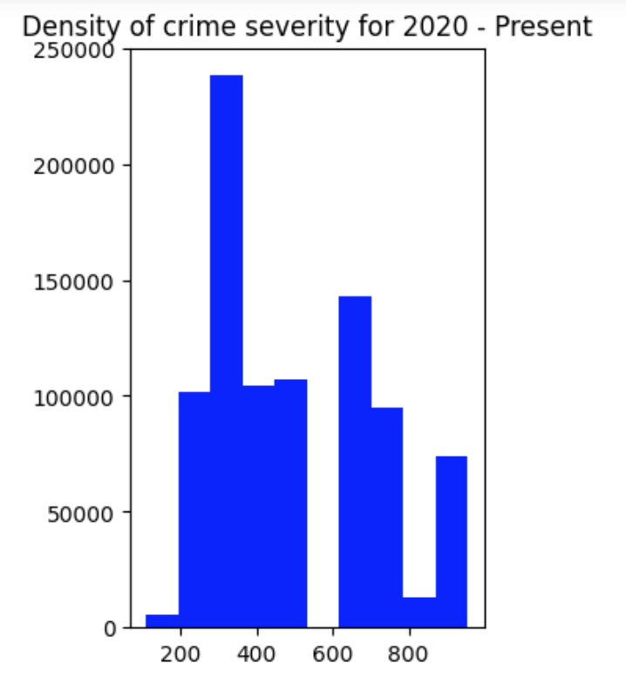
Crime Severity
I conducted exploratory data analysis on our predictors and created bar plots to gain a preliminary understanding of their relationship with severe crimes. Later in the report, I will conduct modeling to understand which of these relationships are most significant. This exploratory analysis was done for severe crimes only as that is what I am mainly trying to predict. I have denoted severe crimes as those with crime codes lower than 300.

Slide 12
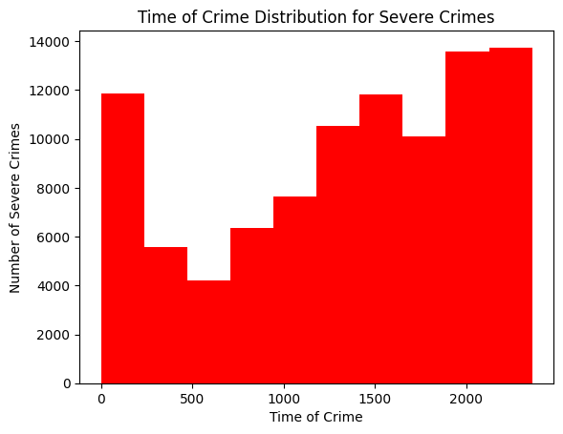
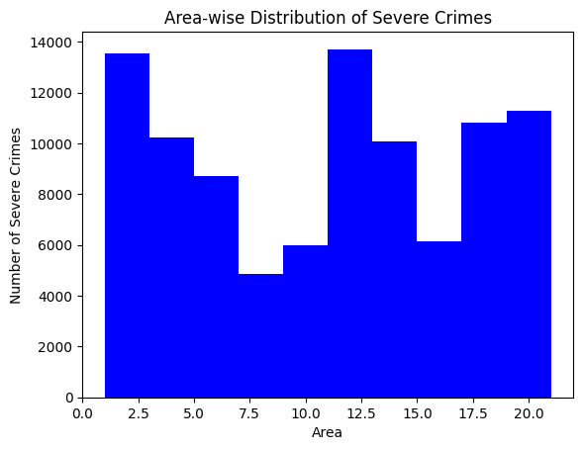

Slide 13
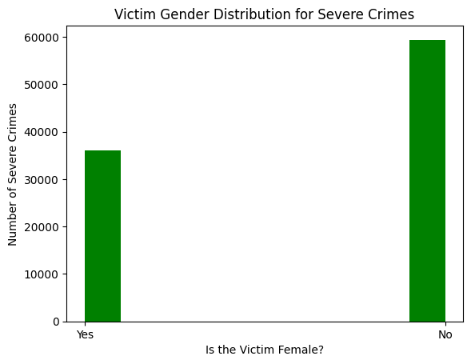
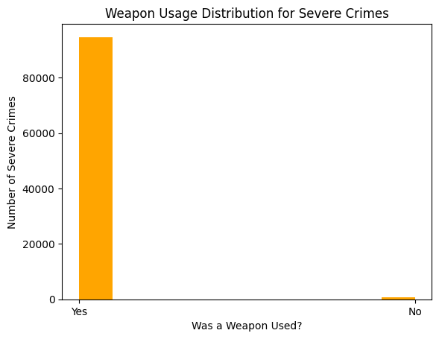
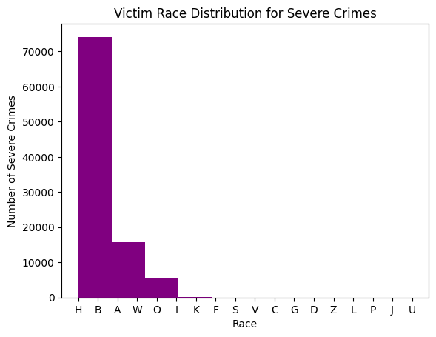

Slide 14
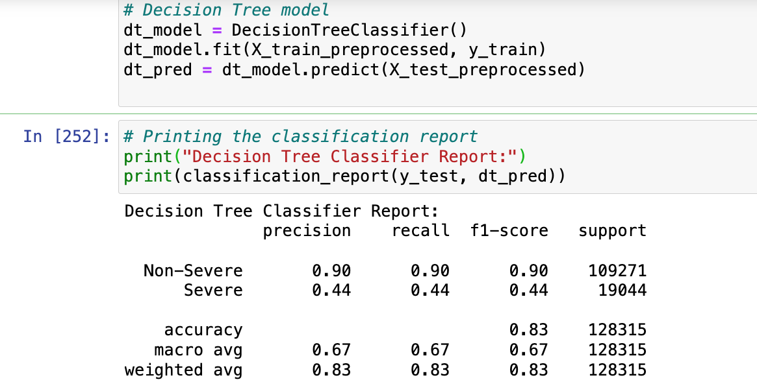
Decision Tree
A precision of 0.44 for severe crimes indicates that only 44% of the crimes predicted as severe were actually severe, while the rest were misclassified.

Slide 15
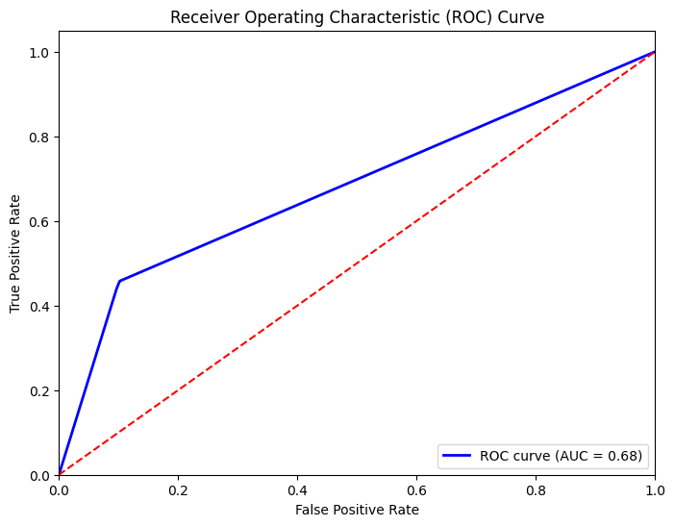
ROC Curve for Decision Tree
AUC of 0.68 suggests that the model is better than random guessing but has room for improvement in terms of its ability to correctly classify severe and non-severe crimes.

Slide 16
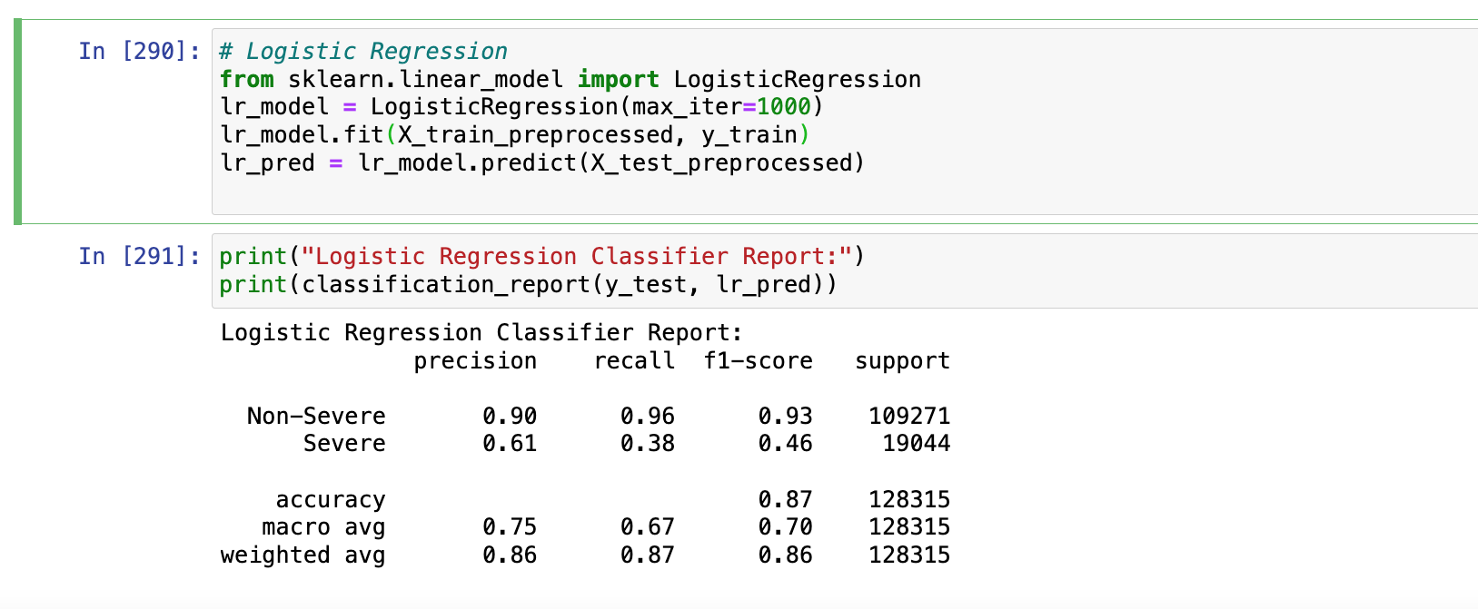
Logistic Regression
The precision for Severe crimes is higher for the Logistic Regression classifier, indicating that when the model predicts a crime to be severe, it is correct more often

Slide 17
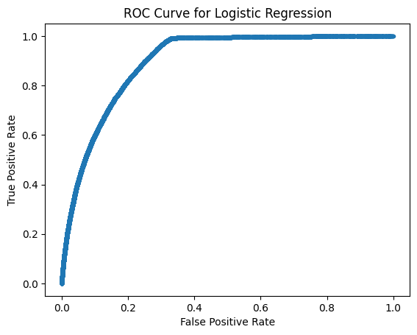
ROC Curve for Logistic Regression
AUC of 0.86 is quite good and suggests that the logistic regression model has strong predictive power for distinguishing between severe and non-severe crimes.

Slide 18
Model Comparision
Metric | Logistic Regression | Decision Tree
Precision | 0.61 | 0.44
Recall | 0.38 | 0.44
F1-score | 0.46 | 0.44
Accuracy | 0.87 | 0.83

Slide 19

CONCLUSION
Based on our analysis across different models, it's evident that certain factors consistently emerge as strong predictors of severe crimes. These include Weapon, Sidewalk, Street, Female, and Age. The presence of a Weapon stands out as a consistent indicator, logically suggesting a higher likelihood of violence in such situations.
Moreover, variables like Race (specifically Hispanic and Black demographics) and Area (particularly the South) also demonstrate a notable association with severe crimes, as highlighted in our logistic regression findings. This suggests that demographic and geographical factors may also play a significant role in predicting the occurrence of severe crimes.

Slide 20

References
Data.gov home. (n.d.). Data.gov. https://data.gov/
Classification: ROC Curve and AUC. (n.d.). Google for Developers. https://developers.google.com/machine-learning/crash-course/classification/roc-and-auc

